Slide 1

Covid Vaccine
Prepared by: Christine Karani
7th June 2024

Slide 2
Contents
Background
Objectives
Study Design
Executive Summary
Key Findings
Conclusion
Recommendation

Slide 3
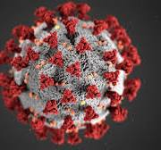
Background Information
COVID-19 is a disease caused by the SARS-CoV-2 virus, first identified in Wuhan, China, in December 2019.
The virus spreads mainly through respiratory droplets, causing symptoms like fever, cough, and difficulty breathing.
The pandemic led to global health crises, economic disruptions, and significant changes in daily life.
New variants of the virus have continued to emerge, requiring ongoing public health efforts and adaptations.
Vaccines and treatments were developed rapidly, with mass vaccination campaigns starting in late 2020.

Slide 4



Objectives of the study
Confidence: To understand the level of confidence on the covid vaccine
Likelihood: Get to know the probability of people willing to get vaccinated on its availability
Reason for the contrary opinion: Primary reason for not taking the vaccine at its disposal

Slide 5


Study Design
Methodology | This was a Qualitative Survey whereby respondents were reached through Random Digit Dialling (RDD)
Objectives | Study to determine the perception and willingness to partake in the covid 19 vaccine exercise
Data Collection Dates | 28th February 2021 to 3rd March 2021
Target Respondents | Nationwide
Sample size | n=400

Slide 6
Executive Summary
Demographics
Gender: The gender sample distribution was 50%-50%
Age group: Target age was 15 years and above. 26 to 35 were the least with a percentage of 27. 15 to 25 were 33% whereas 26+ were the highest with 40%.
Likelihood
Majority of the respondents 61% are willing or likely to get the vaccine while 30% are not willing or probably will not get the vaccine. Only 9% are unsure.
Vaccine Confidence
Most (30%) of the respondents are fairly confident; 23% are very confident; 33% are Not at all confident or Not very Confident; 15% are unsure of the vaccine.
For those who are not confident, majority indicated that they are adamant due to Potential Health Risk (33%) and Uncertainty of Vaccine Effectiveness (31%).

Slide 7
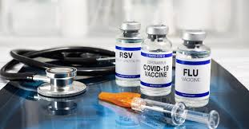
Key Findings
Likelihood By Age group
The age group 35+ leads in the percentage of respondents who are likely to get the vaccine (62%), followed closely by those aged 25–34 (61%) and 18–24 (60%). The highest percentage of respondents who are very certain they will not get the vaccine comes from the 25–34 age group, at 23%.
n=400
If a COVID-19 vaccine was available for free today, would you get it as soon as possible?

Slide 8
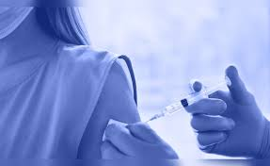
Likelihood by Gender
Females lead with 62% of respondents indicating a willingness to get vaccinated as soon as it becomes available, followed closely by males at 61%. Only 19% of respondents from both genders are very certain that they will not get the vaccine.
n=400
If a COVID-19 vaccine was available for free today, would you get it as soon as possible?

Slide 9
Covid 19 Vaccine Confidence
Overall, 53% of respondents expressed confidence in the vaccine, while 33% were not confident and 15% were unsure about how they felt. The age group 25–34 recorded the highest level of confidence at 54%, followed by the 18–24 age group at 51%, and those aged 35 and above at 50%.
n=400
How confident are you in a COVID-19 vaccine?

Slide 10
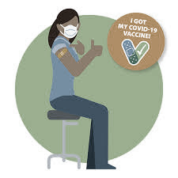
Covid 19 Vaccine Confidence By Gender
Among the genders, males (56%) are more confident in the COVID vaccine compared to females (51%). Additionally, 14% of respondents from both genders reported being Not at all confident in the vaccine.
n=400
How confident are you in a COVID-19 vaccine?

Slide 11
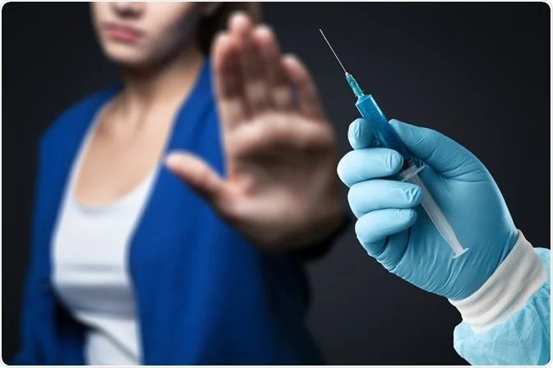
Reason For Lack of Confidence
Out of the respondents who mentioned that they will not get the vaccine, the most selected reason for this was Potential Health Risk with a percentage of 33. Uncertainty of the vaccine effectiveness followed closely with 31% and the third most mentioned reason was Lack of knowledge or awareness with 22%.
n=156
What is the primary reason you aren't likely to take the vaccine?

Slide 12
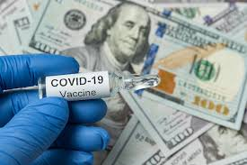
Vaccine Cost
Most (49%) of the respondents are not sure if they will pay for the vaccine. 31% will not pay whereas 21% will pay.
n=400
Would you be willing to pay full or part of the cost of the vaccine?

Slide 13
Conclusion
Likelihood: Majority of the respondents are likely to get the vaccine. 63% of the respondents recorded this. The 37% who are not willing to be vaccinated pointed out that; there is potential health risk associated with vaccination, uncertainty of vaccine effectiveness and lack of knowledge for the vaccine.
There needs to be sensitization of the benefits and health side effects if any, for people to stop doubting.
Confidence of the vaccine: About half of the population is confident of the vaccine.
There needs to be real life examples for people who have used the vaccine to encourage those who are not sure of it

Slide 14
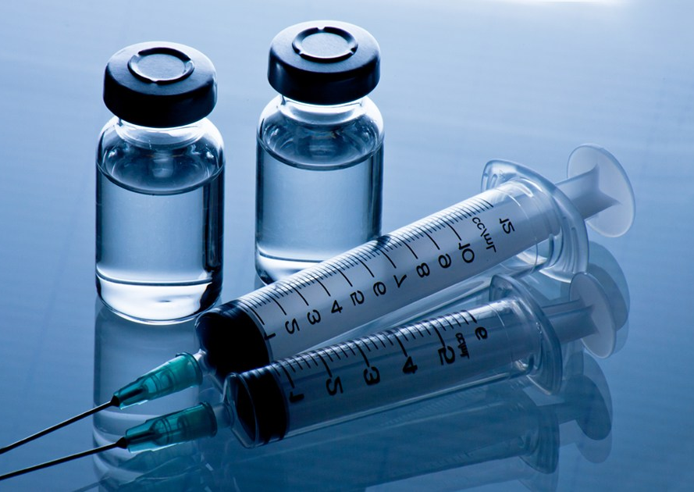
Thank You

